Slide 1

Content Manager Assignment
Srijan Mishra

Slide 2
Outline
Objective
Proposal
Wireframes
Content Pegs & Calendar

Slide 3
Objective
Grow and scale-up in Tier 2 cities of India (TG - 23-26 yrs old)
Some of the top Tier 2 cities of India are: Amritsar, Bhopal, Bhubaneswar, Chandigarh, Faridabad, Ghaziabad, Jamshedpur, Jaipur, Kochi, Lucknow, Nagpur, etc.

Slide 4
Identifying Social Platforms
In order to reach the desired TG (tech/engineers), we first need to identify the best possible platforms to use.
Instagram
YouTube
Facebook
LinkedIn
Twitter
Notes:
For reference: Link

Slide 5
Facts
The social platforms used by our TG, statistically are:
Instagram
Facebook
Twitter
LinkedIn
The top visited websites are:
Google
YouTube
Amazon
Facebook
Notes:
For Reference: Link

Slide 6
Assumptions
As we know, most individuals (including software developers, engineers, programmers, etc.) who are intend to learn something new or want to get a tutorial, the first place the probably visit google and then mostly YouTube. Therefore it is best to utilize YouTube as well for the best results.

Slide 7
Proposal

Slide 8
Brief
The strategy needs to be divided into three segments -
Brand Recognition and Value - First the audience need to be educated about what Recro is and how is it beneficial for them via various pieces of content on all social media platforms.
Building Trust - It is important for people to know and see the results by Recro, we can execute this by multiple methods such as influencers, testimonials, etc.
Differentiator - What is different that we are offering from our competitors or how we can say/prove that our services are superior to others.

Slide 9
Video Content
As important as it is to push out content that is quirky and shareable, it is crucial to have someone communicate with the audience via short video clips, reels, etc. which as per my research lacks on our channels. When such content is shared on the marketing channels, it gains trust and video content tend to have better recall value, better communication, performs much better, and the benefits goes on.
These clips can be shared on Instagram, Facebook, YouTube Shorts, etc. which majorly covers our marketing penetration.
Some of the examples that has shown proven results are, Mailchimp, Copyposse, GaryVee, Hubspot, etc.

Slide 10
Wireframes

Slide 11
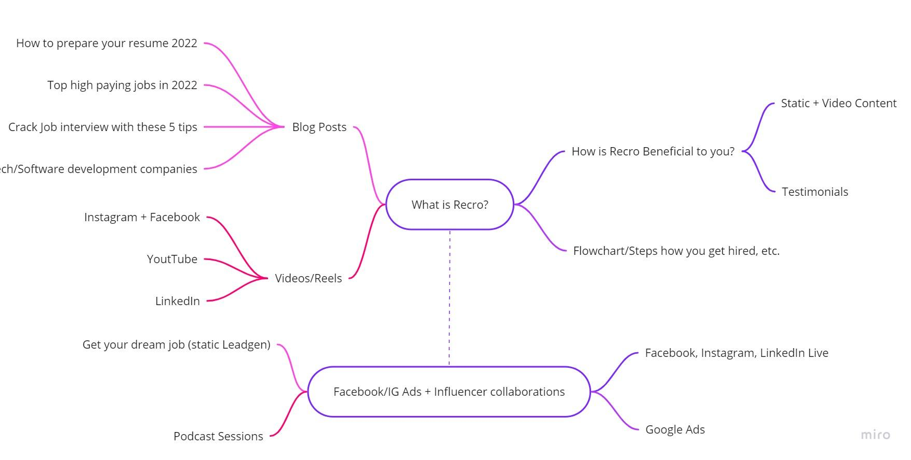
Basic Mindmapping strategy for Recro

Slide 12
Content Calendar

Slide 13
In the link below, please find the content pegs and calendar
Link

Slide 14
Thank you!

